Slide 1


PORTFOLIO
Presented By : Ahmad Hanafi

Slide 2
TABLE OF CONTENT
01
BUSINESS UNDERSTANDING
02
DATA PREPROCESSING
03
DATA ANALYSIS
04
CONCLUSION

Slide 3
BUSINESS UNDERSTANDING
Based on dataset, The team want to see insight about these:
Which top 5 locations that are had highest user using the platform and which are the least 3 locations user?
In which hour that had highest user?
Where is the location type that had highest user using the platform?
Which smarphone brand that highest user in the platform?
How the proportion of digital interest on each group of age (yearborn)?
How the confidence interval of duration and age?

Slide 4


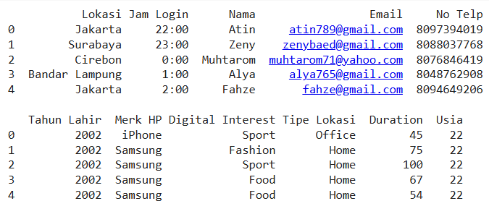
DATA PREPROCESSING
The dataset of DataScientist consist of 11 columns and there are no duplicate or missing value on the data. Here’s the dataset display:

Slide 5
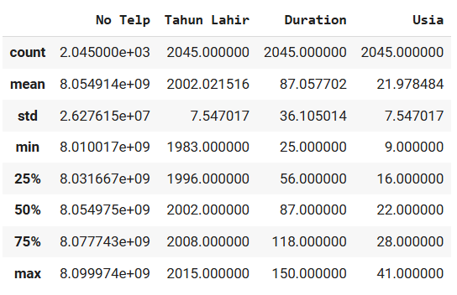

The statistics measure of numerical column in the dataset. Dataset consist of 2045 value. With minimum yearborn are 1983 and maximum yearborn are 2015, with minimum age 9 years old and maximum age are 41. Average of duration are 87 minutes, with the longest are 150 minutes.
DATA ANALYSIS

Slide 6
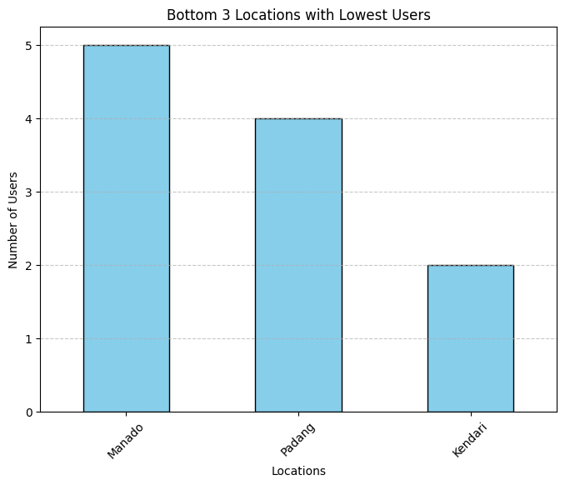
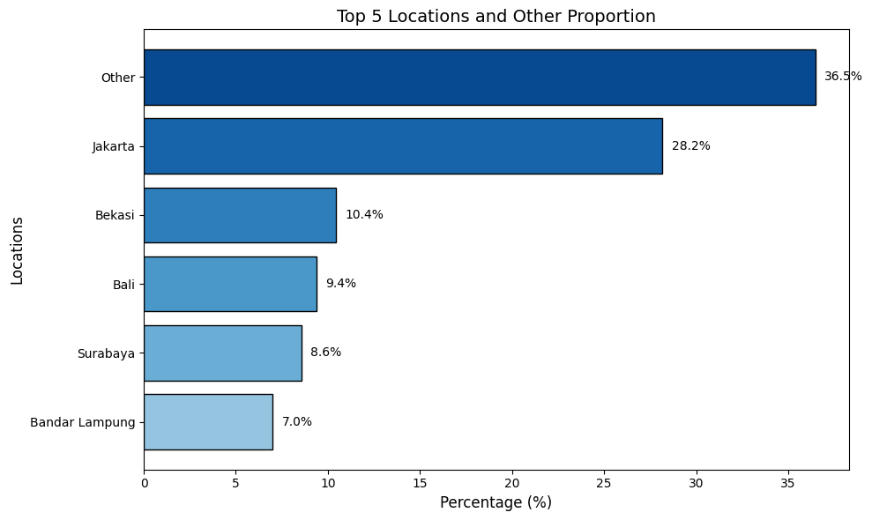
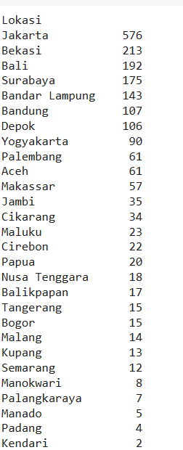
USER BASED ON LOCATION

Slide 7
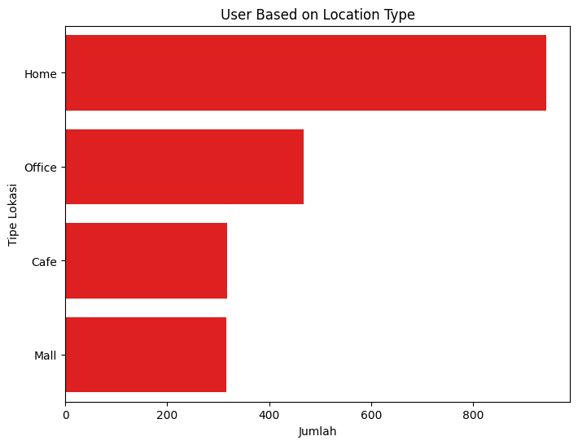
USER BASED ON LOCATION TYPE

Slide 8
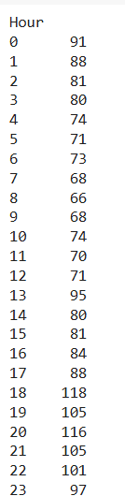
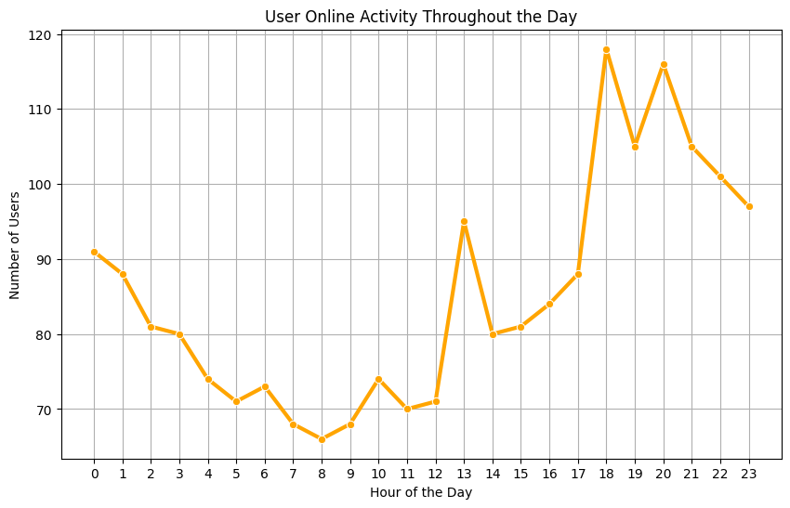
USER BASED ON HOUR

Slide 9
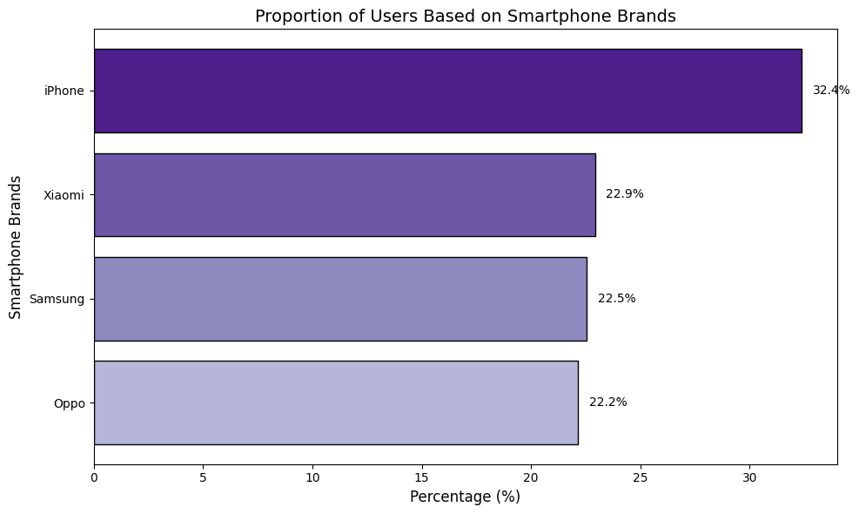
USER BASED ON SMARTPHONE BRAND

Slide 10
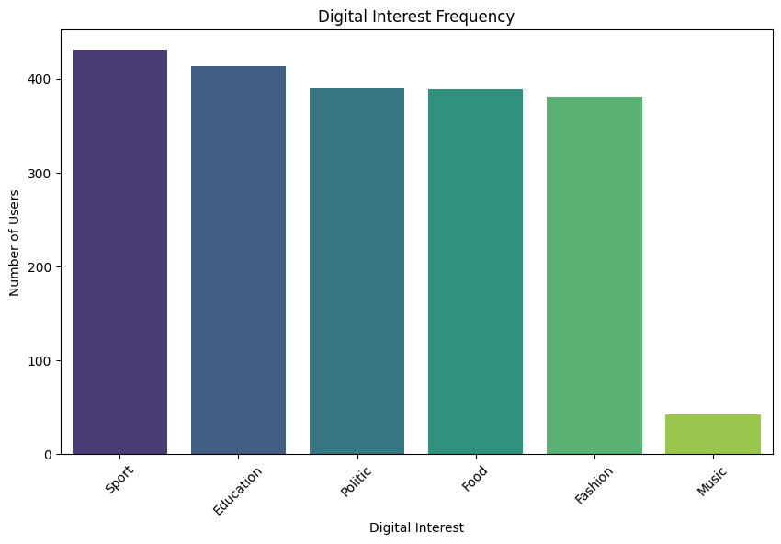
PROPORTION USER BASED ON DIGITAL INTEREST

Slide 11
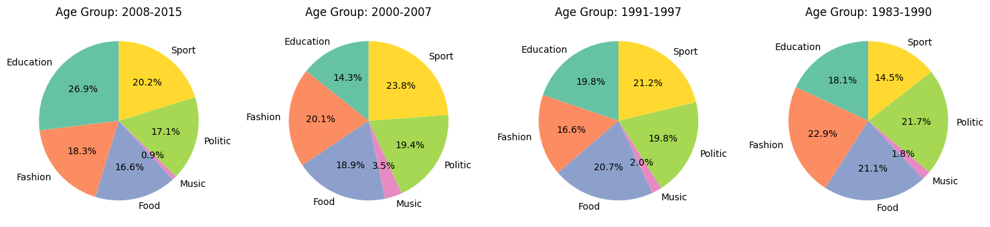
PROPORTION OF DIGITAL INTEREST
BASED ON YEARBORN (AGE GROUP)

Slide 12
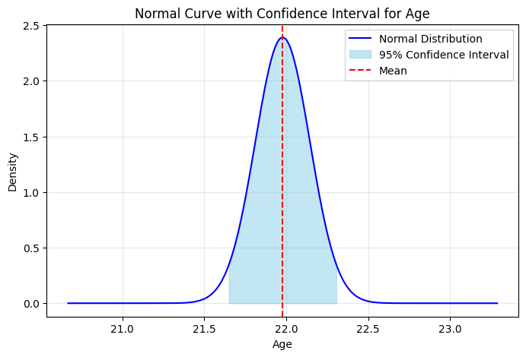
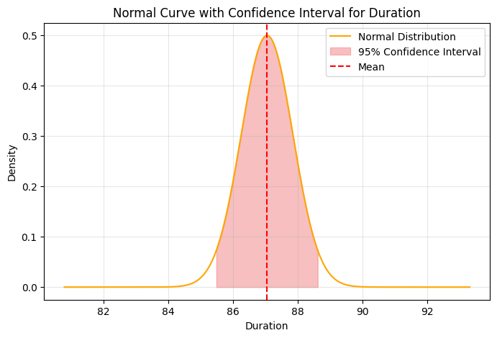
CONFIDENCE INTERVAL

Slide 13
CONCLUSION

Slide 14



TOP 5 WITH HIGHEST USER ARE JAKARTA (28,2%), BEKASI (10,4%), BALI (9,4%), SURABAYA (8,6%) AND BANDAR LAMPUNG (7%)
BOTTOM 3 WITH THE LOWEST USER ARE KENDARI (2 USER), PADANG (4 USER), AND MANADO (5 USER)
LOCATION TYPE WITH THE HIGHEST USER ARE IN HOME AND THE LOWEST ARE IN MALL
HIGHEST USER HAPPENING AT 18:00 AND THE LOWEST ARE AT 08:00
HIGHEST USER TEND TO ACCES PLATFORM USING IPHONE (32.4%)
HIGHEST DIGITAL INTEREST ACCESED BY USER ARE SPORT AND THE LOWEST ARE MUSIC
USER ON AGE GROUP (1983-1990) LIKE TO ACCES FASHION AND LEAST TO ACCES MUSIC. USER ON AGE GROUP (1991-1997) AND (2000-2007) MOST ACCES ON SPORT AND LEAST AT MUSIC. AND USER ON AGE GROUP (2008-2015) TEND TO ACCES EDUCATION AND LEAST AT MUSIC.

Slide 15
CONFIDENCE INTERVAL (95%) FOR AGE ARE ON RANGE (21.65 YEARS OLD UNTILL 22.3 YEARS OLD).
CONFIDENCE INTERVAL (95%) ON DURATION ACCESING PLATFORM ARE ON 85.49 MINUTES UNTILL 88.62 MINUTES

Slide 16
THANK YOU
If you have any questions or would like further discussion, please feel free to contact me.
hanapiahmad@gmail.com
https://www.linkedin.com/in/ahmad-hanafi-033087206/
Or for more portfolio/project, can be accessed on:
https://github.com/hanafiiahmd

